Slide 1
LogiSon Revit Families
Quick Facts:
Work with your LogiSon representative to decide on the proper components and placement for your system.
Keep in touch with your LogiSon representative for content updates.
All Revit Families are ‘Face Based’.
All Revit Families have electrical and data.
connection points.

Slide 2
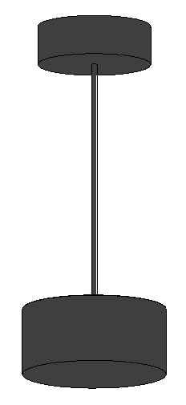
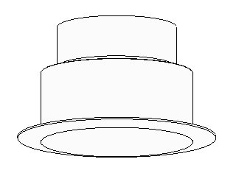
LogiSon Revit Families
Sound Masking Unit: Suspended
Sound Masking Unit: Ceiling

Slide 3


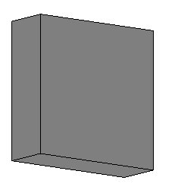
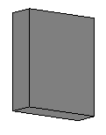
LogiSon Revit Families
Keypad
Power Supply
Network Control Panel
Failsafe Power Supply

Slide 4


LogiSon Revit Families
LogiSon_Network_Data_Device_Tag.rfa
Electrical Equipment Tag.rfa

Slide 5

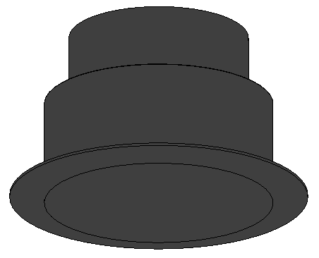
LogiSon Revit Families
Sound Masking Unit, Ceiling Mount
Materials: LogiSon_Charcoal
LogiSon_White
Types: PNH-1
PNH-1p
PNH-1A
SNH-1
Instance Parameter ‘Mark’ is address, ie.99, 100
Revit File Name: LogiSon_Sound_Masking_Unit_Ceiling.rfa
.
Typical Plan Symbol
3D Isometric Shaded

Slide 6
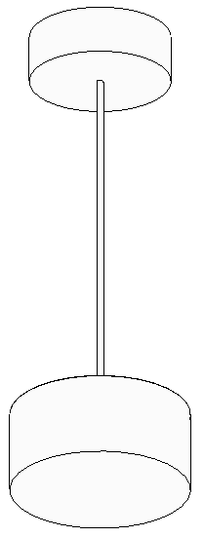
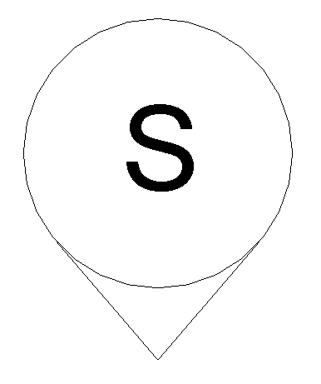
LogiSon Revit Families
Sound Masking Unit, Suspended
Materials: LogiSon_Charcoal
LogiSon_White
Types: PNH-1
PNH-1p
PNH-1A
SNH-1
Instance Parameter ‘Mark’ is address, ie.99, 100
Revit File Name: LogiSon_Sound_Masking_Unit_Suspended.rfa
.
Typical Plan Symbol
3D Isometric Shaded

Slide 7
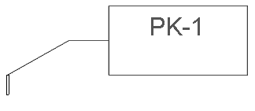
LogiSon Revit Families
Keypad
Revit File Name:
LogiSon_Keypad.rfa
2D Plan View
3D Isometric View

Slide 8
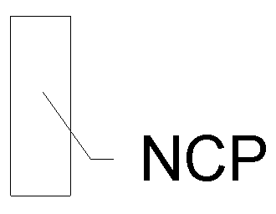
LogiSon Revit Families
Network Control Panel
Revit File Name:
LogiSon_Network_Control_Panel.rfa
2D Plan View
3D Isometric View

Slide 9
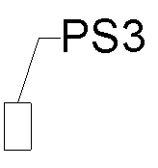
LogiSon Revit Families
Power Supply
Revit File Name:
LogiSon_Power_Supply_PS3.rfa
2D Plan View
3D Isometric View

Slide 10
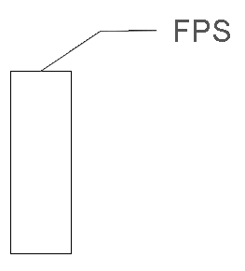
LogiSon Revit Families
Failsafe Power Supply FPS
Revit File Name:
LogiSon_Failsafe_Power.rfa
Plan View
3D Isometric Shaded

